Slide 1
The Human Element of DevOps
Rebecca Long | @amaya30 Seattle Code Camp 2018 | #scc2018

Slide 2
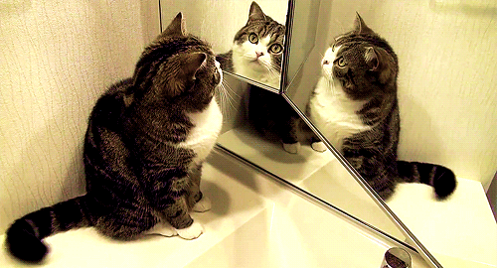

Slide 3

Hello!
Rebecca Long / @amaya30
Spokane, Washington
Bachelor's & Master’s in Computer Science
15 yrs as Software Engineer
10 of those years as Quality Assurance
Most recently officially in a DevOps role
Lead DevOps Engineer at RiskLens
President / Founder of Future Ada

Slide 4

Cyber-risk quantification & management software company

Slide 5

501(c)(3) non-profit advocating and supporting women and non-binaries in STEAM (science, technology, engineering, art, and mathematics)

Slide 6

Okay… Let’s talk about DevOps

Slide 7
First thoughts …
Automation
Integration
Monitoring
Logging
Continuous Integration
Continuous Deployment

Slide 8












SCRIPTING

Slide 9























FUN TOOLS

Slide 10

But what IS DevOps REALLY?

Slide 11
Agile Manifesto
People over process and tools
Working software over documentation
Customer collaboration over customer research
Responding to change over following a plan
http://agilemanifesto.org/

Slide 12
DevOps is a holistic view of software engineering with the goal to get high quality software successfully out the door
Does not start when it’s release time
Does not stop after the software is shipped
Not limited to the software and/or operations team(s)

Slide 13

DevOps
People
Process
Technology

Slide 14


Pillars of DevOps
Collaboration
Affinity
Tools
Scaling

Slide 15

“Collaboration is the process of building toward a specific outcome through supporting interactions and the input of multiple people. A guiding principle that shaped the devops movement was the cooperation of software development and operations teams.” ~ Effective DevOps

Slide 16
“Affinity is the process of building these interteam relationships, navigating differing goals or metrics while keeping in mind shared organizational goals, and fostering empathy and learning between different groups of people.” ~ Effective DevOps

Slide 17
“Tools are an accelerator, driving change based on the current culture and direction. Tool choices can be perceived as easy wins. Understanding why they are wins, and their impact on existing structures, is important to prevent obscuring issues in teams and organizations.” ~ Effective DevOps

Slide 18
FUN TOOLS

Slide 19
“Scaling is a focus on the processes and pivots that organizations must adopt throughout their lifecycles. … There are different considerations, both technical and cultural, for organizations operating at different scales…” ~ Effective DevOps

Slide 20

DevOps in Action

Slide 21

Every Team / Company is Unique

Slide 22

Case Study: Credit Union

Slide 23

Case Study: Start Up

Slide 24
Necessary Skills

Slide 25
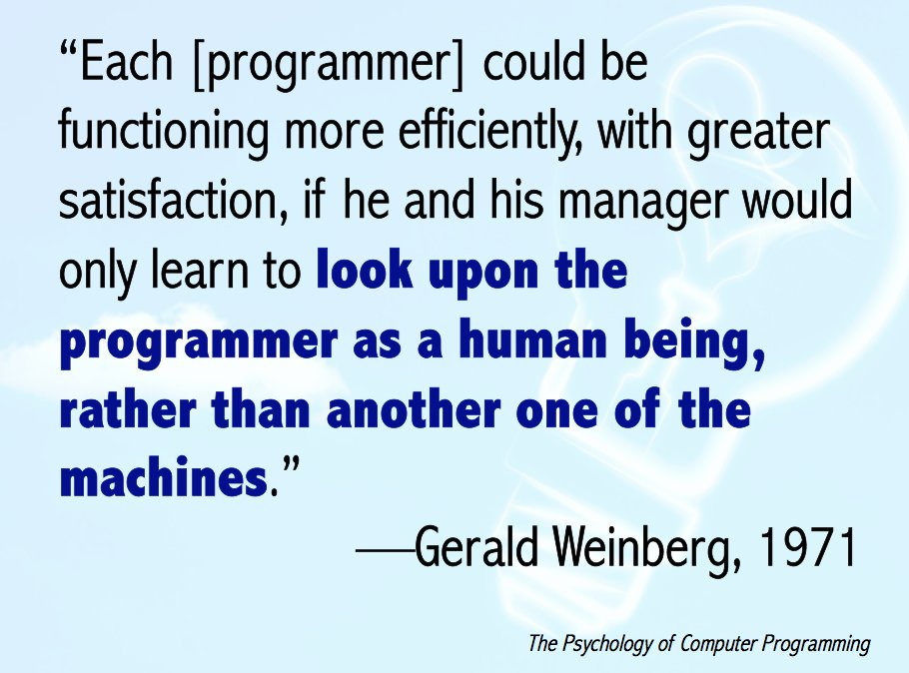

Slide 26
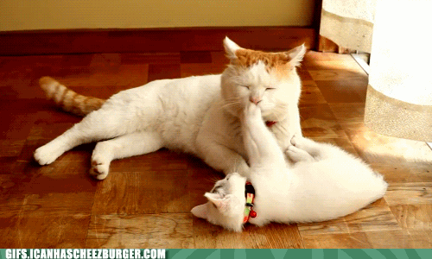
Soft Skills
These are necessary human interaction skills
Just as important as your tech skills
Care about each other enough to learn to interact mindfully and effectively

Slide 27


Slide 28

“Effective communication, in addition to being crucial for distributing information, is key to building a foundation of trust and empathy between individuals, and that foundation is what enables devops to really work.” ~ Effective DevOps

Slide 29
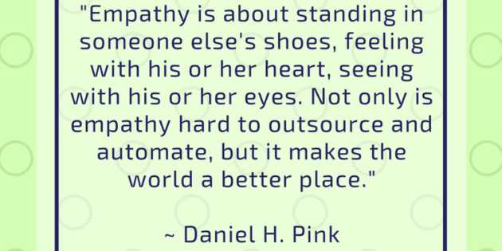

Slide 30
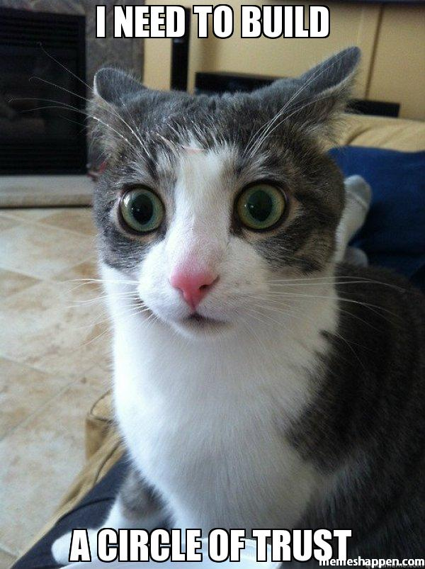
Empathy & Trust
Get to know your coworkers as people
Regularly discuss non-work related topics with coworkers
Family, pets, hobbies, passions, goals, etc.
Builds trust and empathy between team members
Better able to handle stress as a group

Slide 31

Merriam-Webster:
“sympathetic consciousness of others' distress together with a desire to alleviate it”

Slide 32
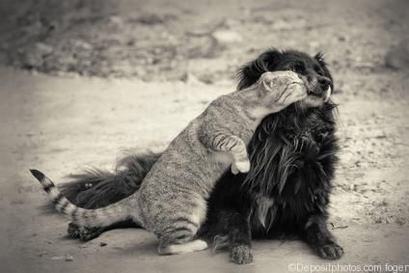
Compassion
Change is hard… have compassion for your colleagues as changes are implemented
Stay in tune with how your team members are reacting to the changes
Do we need to slow down the changes?
Do we need to have extra conversations to walk them through a specific change?
Is there an extra tool you can implement to make the transition easier for someone?

Slide 33


Eliminate Blame & Shame
“Shame can only rise so far in any system before people disengage to protect themselves. When we’re disengaged, we don’t show up, we don’t contribute, and we stop caring.” ~ Brené Brown, Daring Greatly

Slide 34
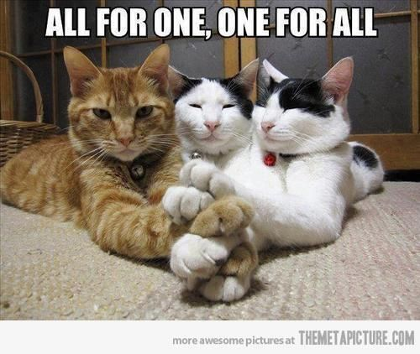
Teamwork & Cooperation
Play nice with others on your team and beyond
Empower the ideas from others
Encourage conversation and questions so everyone can learn and be on the same page
No dumb questions
Focus on the team and the work vs individuals
Extra important when mistakes and/or failures (a.k.a. “learning opportunities”) happen
Team succeeds together
No lone wolves
No “cowboys”

Slide 35
Growth Mindset
Term coined by Dr Carol Dweck
Believe that you can learn the skills you need to do the job
Believe that others can learn the skills they need
Provides confidence to learn and to take necessary risks to create positive changes
Provides confidence to handle failure

Slide 36
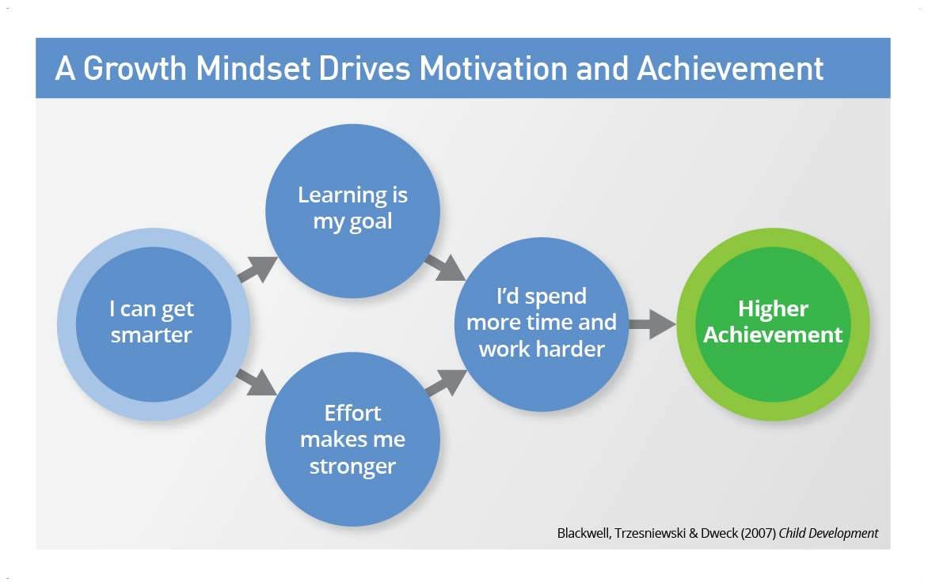

Slide 37
Wrap Up

Slide 38
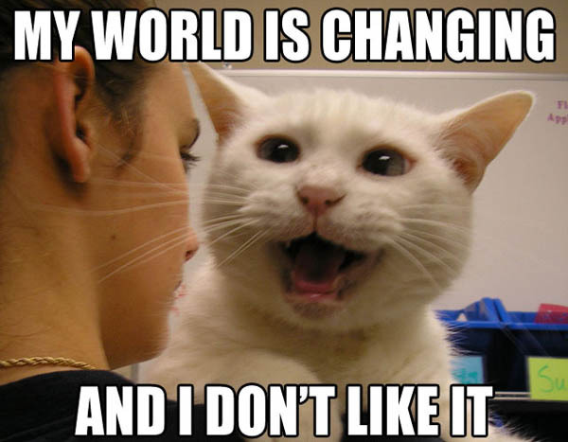
DevOps…
Helps facilitate change via technology & process
Helps create the correct change at the correct time
Helps people through change

Slide 39
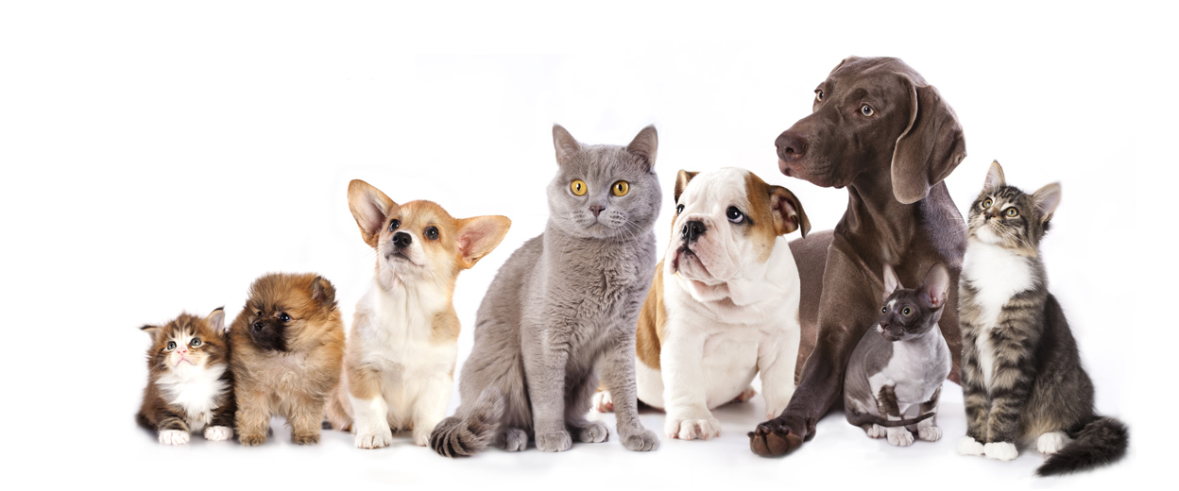
DevOps is the solution to creating a more diverse, inclusive, welcoming, and compassionate tech industry which will generate more inclusive tech for our diverse and ever complex world

Slide 40

As DevOps engineers, it is our responsibility to advocate for these principles and best practices so we can create the best technology possible and ultimately leave the world in a better place

Slide 41


Learn more
Effective DevOps: Building a Culture of Collaboration, Affinity, and Tooling at Scale by Jennifer Davis and Ryn Daniels
Daring Greatly by Brené Brown
Inclusion: Diversity, The New Workplace & The Will To Change by Jennifer Brown
Emotional Intelligence: Why It Can Matter More Than IQ by Daniel Goleman

Slide 42

And even more!
Compassionate Coding https://compassionatecoding.com/
Emotional Intelligence for Engineers by April Wensel from ngAtlanta 2018 https://www.youtube.com/watch?v=SJnVhkEx8Cs

Slide 43

Contact Me
Rebecca Long / @amaya30
http://www.rebeccalong.tech
Future Ada / @futureada
http://www.futureada.org
rebecca@futureada.org
RiskLens / @risklens
https://www.risklens.com/
rlong@risklens.com

Slide 44

Thank you!

